Slide 1
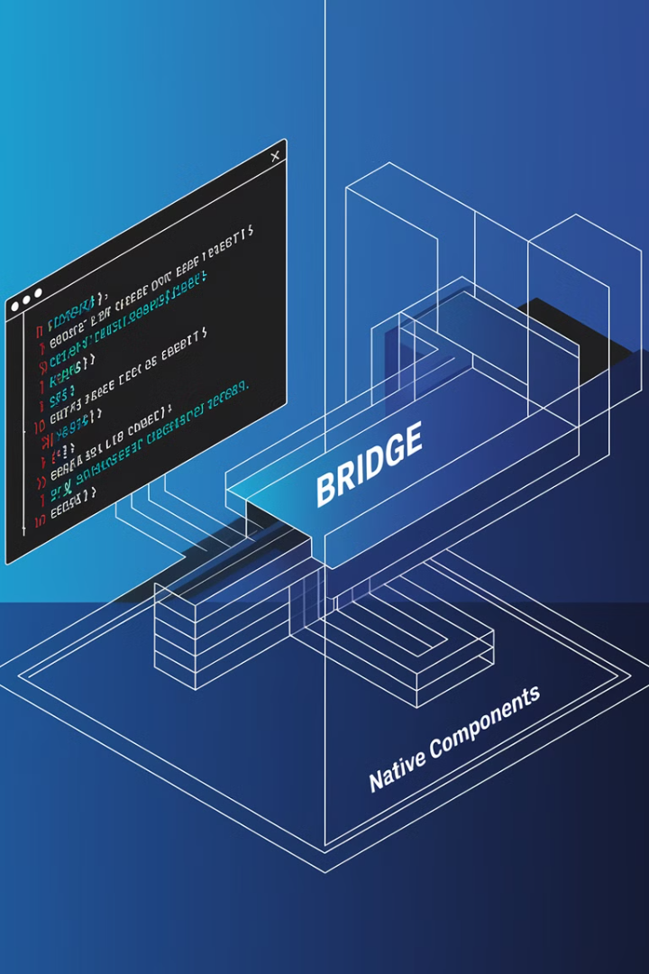

React Native Internals: Understanding the Architecture Under the Hood
Welcome to this comprehensive exploration of React Native's internal architecture. In this presentation, we'll dive deep into how React Native enables seamless cross-platform development while maintaining native performance. You'll gain insights into the core components, threading model, and communication mechanisms that power React Native applications.
By understanding these internals, you'll be better equipped to optimize your applications, troubleshoot performance issues, and leverage React Native's capabilities to their fullest potential. Let's uncover what makes React Native tick!

Slide 2

Learning Objectives
1
Identify Core Architecture Components
Understand the fundamental building blocks of React Native's architecture and how they work together to create seamless mobile experiences across platforms.
2
Master Shadow Tree & Yoga Layout
Learn how the Shadow Tree works in conjunction with the Yoga Layout Engine to efficiently render UI components across different device screens.
3
Understand Thread Architecture
Discover how React Native's multi-threaded design enables smooth performance by separating different types of operations.
4
Explore JavaScript Bridge
Grasp the communication mechanism that allows JavaScript code to interact with native platform capabilities.

Slide 3

The Value of Understanding React Native Internals
Performance Optimization
Effective Debugging
Better Architecture Decisions
Knowing how React Native works under the hood allows you to identify and resolve bottlenecks, ensuring your applications run smoothly across different devices and platforms.
When issues arise, understanding the internal architecture helps you pinpoint the exact layer where problems occur, significantly reducing debugging time.
With knowledge of how JavaScript and native code interact, you can make informed decisions about component structure, state management, and native module integration.

Slide 4
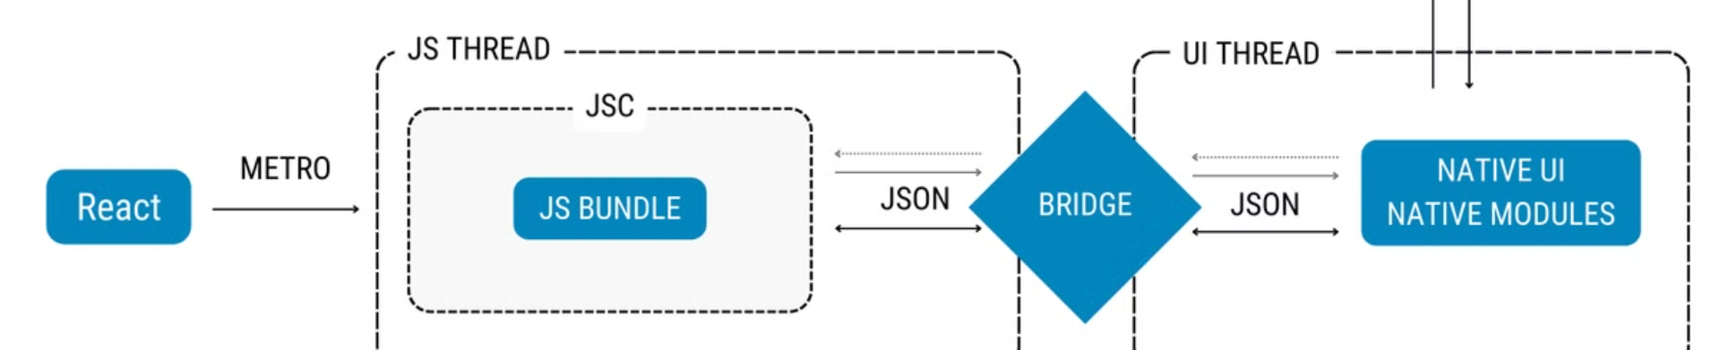
React Native Architecture Overview
UI Thread (Main Thread)
Shadow Tree & Yoga
The platform-specific main thread handles all UI rendering operations. It receives instructions from the JavaScript thread via the bridge, manages the view hierarchy, and handles touch events, ensuring smooth 60fps animations and responsive interfaces.
Bridge & Native Modules
React components generate a lightweight "shadow tree" of layout information. The Yoga layout engine (a cross-platform implementation of Flexbox) calculates precise positioning before rendering native UI components, ensuring consistent displays across devices.
JavaScript Thread
The bridge enables bidirectional communication between JavaScript and native platforms. Native modules expose platform-specific APIs (camera, geolocation, etc.) to JavaScript through a serialized, asynchronous messaging system, allowing access to device capabilities.
React Native executes your JavaScript code in a separate thread using a JavaScript engine (Hermes or JSC). This thread handles React component logic, state management, and processes user events while being isolated from UI operations.

Slide 5




Native Modules: The Bridge to Platform Capabilities
Android Integration
iOS Integration
Unified API
Native modules written in Java or Kotlin connect your JavaScript code to Android-specific capabilities, allowing access to device features while maintaining a consistent API.
On iOS, modules implemented in Objective-C or Swift provide the necessary bridges to access platform features, ensuring your application can leverage all iOS capabilities.
The beauty of Native Modules is that they provide a consistent JavaScript interface regardless of platform, allowing your code to remain largely platform-agnostic.

Slide 6

When to Use Native Modules
1
Hardware Access
When your application needs to interface with device-specific hardware such as cameras, microphones, sensors, or GPS that can't be directly controlled through JavaScript alone.
2
Performance-Critical Operations
For computationally intensive tasks that would cause lag if run on the JavaScript thread, such as image processing, complex calculations, or real-time data analysis.
3
Platform-Specific UI Components
When you need to incorporate UI elements that are unique to a specific platform or require deep integration with the native rendering system for optimal performance.
4
Third-Party SDK Integration
To incorporate platform-specific SDKs or libraries that don't have JavaScript equivalents, such as advanced analytics tools or platform-specific authentication mechanisms.

Slide 7




Native Module Example: Barcode Scanner
JavaScript Interface
Bridge Communication
Native Implementation
Result Callback
Your React component includes a simple function call like scanBarcode() when a user presses a button. This provides a clean, platform-agnostic API for your application logic.
Once a barcode is detected, the result is sent back across the bridge to your JavaScript code, where you can update your application state and UI accordingly.
The JavaScript call is serialized and sent through the bridge to the appropriate native module. The bridge handles all the complexity of cross-context communication.
Platform-specific code (Java/Kotlin for Android, Objective-C/Swift for iOS) accesses the camera API, captures frames, and processes them using native barcode libraries.

Slide 8
Shadow Tree & Yoga Layout Engine: UI Rendering Pipeline
Efficient Updates
Layout Application
When state changes occur, React Native only recalculates the portions of the Shadow Tree that are affected, minimizing the computational overhead and ensuring smooth UI updates.
Yoga Layout Calculation
Once calculations are complete, the resulting layout information is applied to actual native views. This transforms abstract positioning into platform-specific UI elements that users can see and interact with.
Shadow Tree Creation
React Native constructs a lightweight representation of your UI hierarchy called the Shadow Tree. This mirrors your component structure but is optimized for layout calculations rather than rendering.
The Yoga Layout Engine applies Flexbox rules to determine the precise position and size of each component in the Shadow Tree. This happens on a dedicated thread to maintain UI responsiveness.

Slide 9




Deep Dive: Shadow Tree Creation and Structure
Component Definition
Virtual DOM Representation
Your JSX code defines a hierarchical structure of components with style properties and content.
1
React processes your components into a virtual DOM representation, tracking their relationships and properties.
2
Optimization
Shadow Node Creation
4
The Shadow Tree contains only information necessary for layout calculations, making it lightweight and efficient.
3
For each component in the virtual DOM, React Native creates a corresponding node in the Shadow Tree with layout-specific properties.
The Shadow Tree serves as a crucial intermediate representation between your React components and native UI elements. By focusing solely on layout properties, it allows React Native to perform rapid calculations without the overhead of managing actual view instances.
Each node in the Shadow Tree contains information about sizing constraints, margin, padding, and position. This specialized structure enables the Yoga Layout Engine to efficiently apply Flexbox rules to determine the final layout.

Slide 10
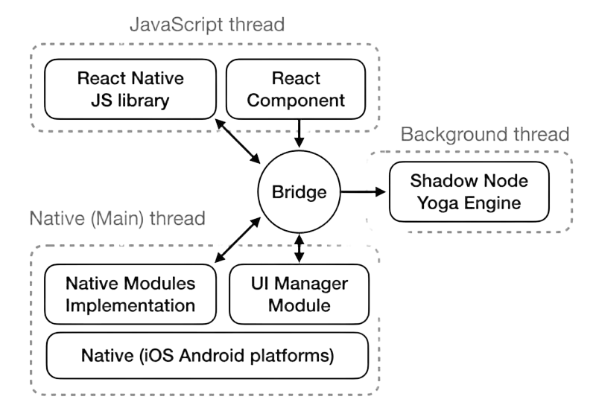
React Native Thread Architecture
Main Thread (UI Thread): Handles native UI rendering and user interactions. This is the same thread that would run an entirely native application. All UI updates must ultimately be processed here to be visible to users.
JavaScript Thread: Executes all JavaScript code including React's reconciliation, application logic, and state management. This thread determines what should be displayed but doesn't directly manipulate UI elements.
Shadow Thread: Dedicated to layout calculations using the Yoga Layout Engine. By processing these computations on a separate thread, React Native prevents layout work from blocking either UI rendering or JavaScript execution.
Native Module Threads: Complex native operations can spawn additional background threads to avoid blocking the main thread, ensuring the UI remains responsive even during intensive operations.

Slide 11



The Critical Role of the Main Thread
User Input Processing
Native UI Rendering
Animation Execution
Handles touch events, keyboard input, and other user interactions, ensuring responsive feedback
Draws all visual elements on screen using platform-specific rendering engines
Processes animation frames to ensure smooth 60fps visual transitions
The Main Thread (also called the UI Thread) is the most critical thread for providing a smooth user experience. Any operation that blocks this thread for more than 16ms will cause dropped frames and visible stuttering in your application.
This is why React Native's multi-threaded architecture is so important - it allows your JavaScript logic and layout calculations to run on separate threads, preventing them from blocking UI rendering and user input processing. The result is a more responsive application that maintains the smooth, native feel users expect.

Slide 12
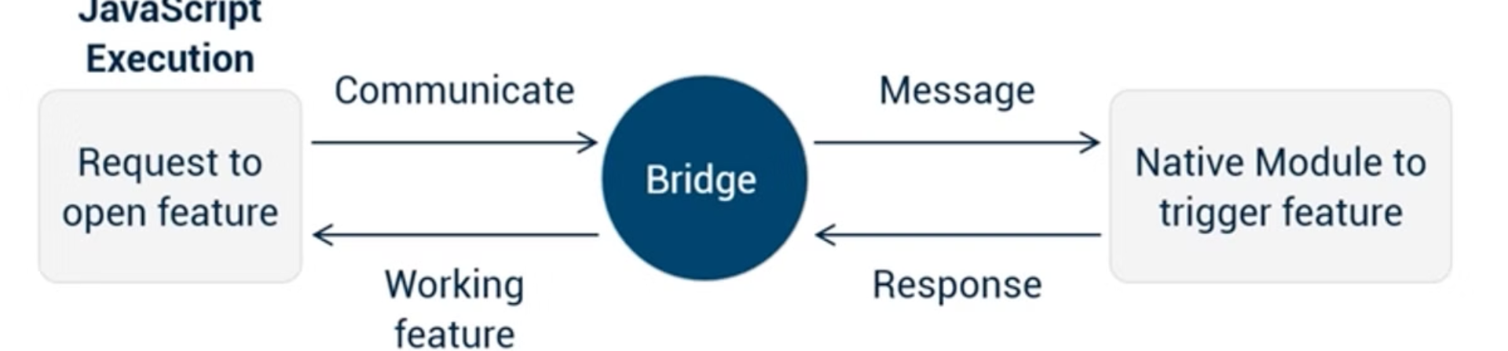
JavaScript Bridge
JavaScript Bridge, a crucial part of an app that provides seamless native communication between the JavaScript code and platform-specific native components.
The Bridge serves as a communication layer that serializes data between the JavaScript thread and the native modules. It translates JavaScript function calls into their native counterparts and passes data back and forth using JSON objects.
This bidirectional communication channel enables React Native applications to access device-specific features like cameras, geolocation, and sensors while maintaining the development efficiency of JavaScript. However, the serialization process can introduce performance overhead for data-intensive operations.

Slide 13




JavaScript Bridge: Communication Mechanism
Context Boundary
Bidirectional Communication Channel
Serialized JSON Message Format
Asynchronous Batch Communication
Separates JavaScript VM from native runtime environment
All data is converted to strings for cross-context transmission
Messages are grouped and sent in batches for efficiency
Allows JavaScript to call native functions and receive callbacks
The JavaScript Bridge serves as the communication highway between the JavaScript thread and the native threads. It facilitates the exchange of messages, enabling your JavaScript code to invoke native functionality and receive results back after execution.
While essential to React Native's architecture, the bridge does introduce some overhead due to the serialization/deserialization process and asynchronous nature of the communication. Understanding this overhead is crucial for optimizing performance-critical sections of your application.

Slide 14

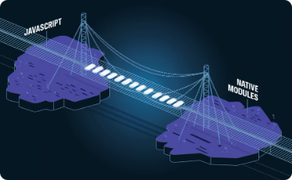
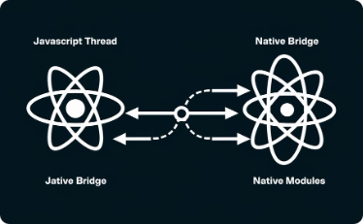
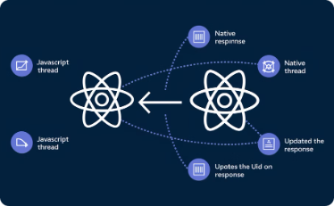
Bridge Communication Process
1. JavaScript Execution
2. Bridge Communication
3. Native Processing
4. Response Handling
User interaction triggers JavaScript code execution. The code determines an action is needed that requires native functionality, such as accessing the camera or retrieving location data.
The native side receives and parses the message, identifies the appropriate module and method, then executes the requested functionality using platform APIs. Results are prepared for the return journey.
The native code sends results back across the bridge as a serialized message. JavaScript code receives this response, updates application state, and renders any UI changes needed to reflect the completed operation.
JavaScript constructs a message containing the requested native module name, method, and any necessary parameters. This message is serialized to JSON and queued for transmission across the bridge.

Slide 15

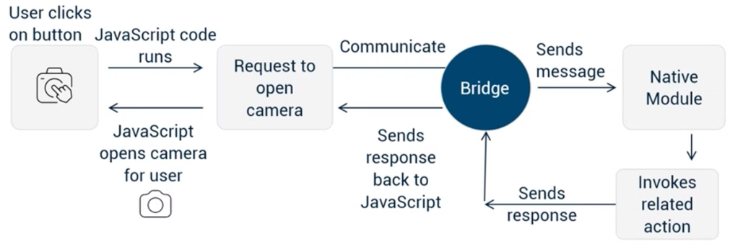




Real-World Example: Camera Photo Capture
User Initiates Capture
Bridge Messages
Native Processing Time
Data Transfer
User taps a "Take Photo" button in your React Native app, triggering an onPress event handler in your JavaScript code.
JavaScript sends a message through the bridge requesting the camera module to activate and capture an image. This message is serialized and queued for processing.
The native camera module receives the request, activates device hardware, captures the photo, and processes the image data—all in platform-specific code.
The processed image (potentially compressed or resized) is sent back across the bridge to JavaScript as a base64 string or file URI reference.

Slide 16
Key Takeaways
Native Modules
Shadow Tree & Yoga Layout
Native Modules let your app use features specific to each platform.
The Shadow Tree and Yoga Layout Engine work together to make sure your app's interface looks good on all devices.
Thread Architecture
JavaScript Bridge
React Native uses multiple threads to keep your app running smoothly. This means heavy JavaScript tasks won't slow down the user interface.
The JavaScript Bridge is a key component that helps the different parts of your app talk to each other, letting you use native features while keeping development simple.
With this knowledge about how React Native works inside, you can now build better apps, fix performance problems, and make smarter technical choices. You've gone from just using React Native to truly understanding it.

